Slide 1
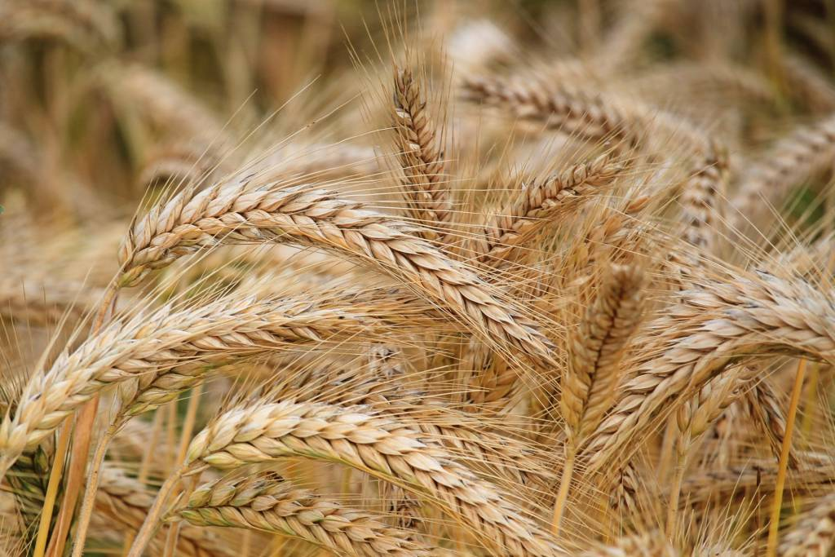
Spring Wheat Yield Clustering & Analysis
RM Level and yearly crop analysis on Spring Wheat – By Neha

Slide 2
Problem Statement & Data Collection
RM's: 296
Years: 2002 to 2023
Source: SK Government Website
The demand of the wheat crop has been increased in past few years so this analysis will focus on the past yield and locations in Saskatchewan and will forecast the next 2 years yield
https://www.saskatchewan.ca/business/agriculture-natural-resources-and-industry/agribusiness-farmers-and-ranchers/crops-and-irrigation/field-crops/cereals-barley-wheat-oats-triticale/wheat-canada-prairie-spring-wheat
https://dashboard.saskatchewan.ca/business-economy/business-industry-trade/crop-production#by-commodity-tab
Palette Skills

Slide 3
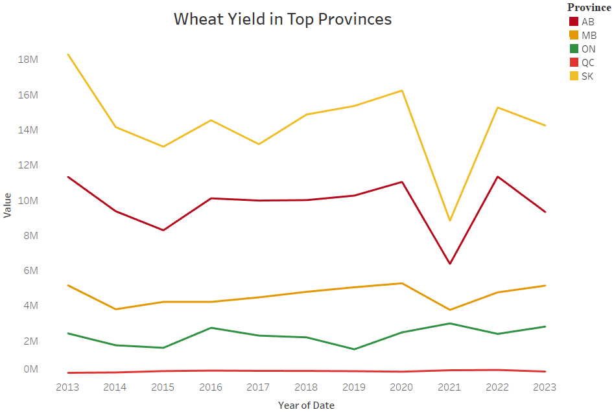
Top 5 Provinces of Canada in Wheat Crop Yield

Slide 4
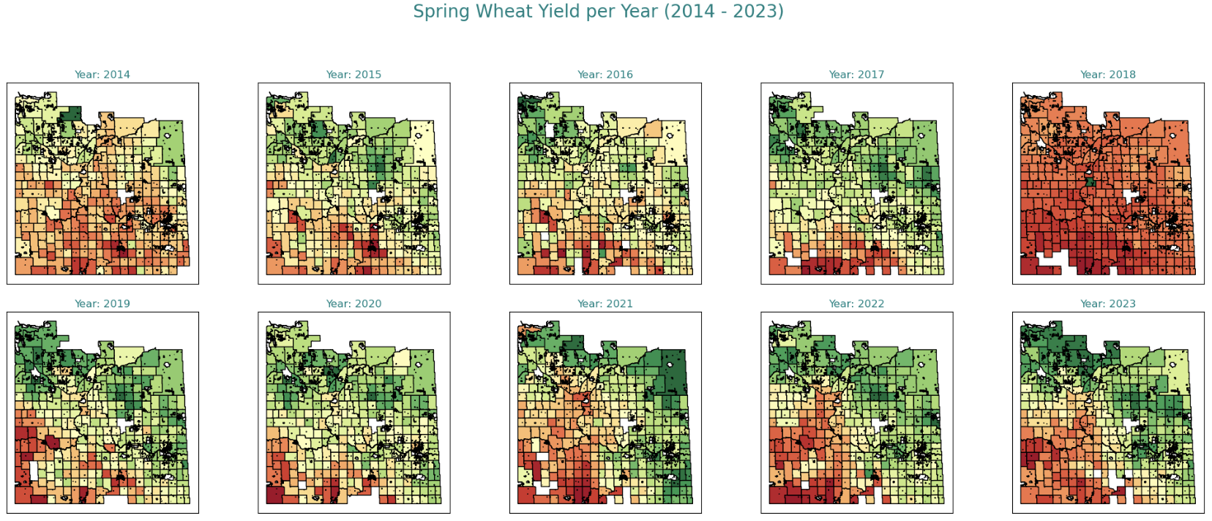
Exploratory Data Analysis

Slide 5
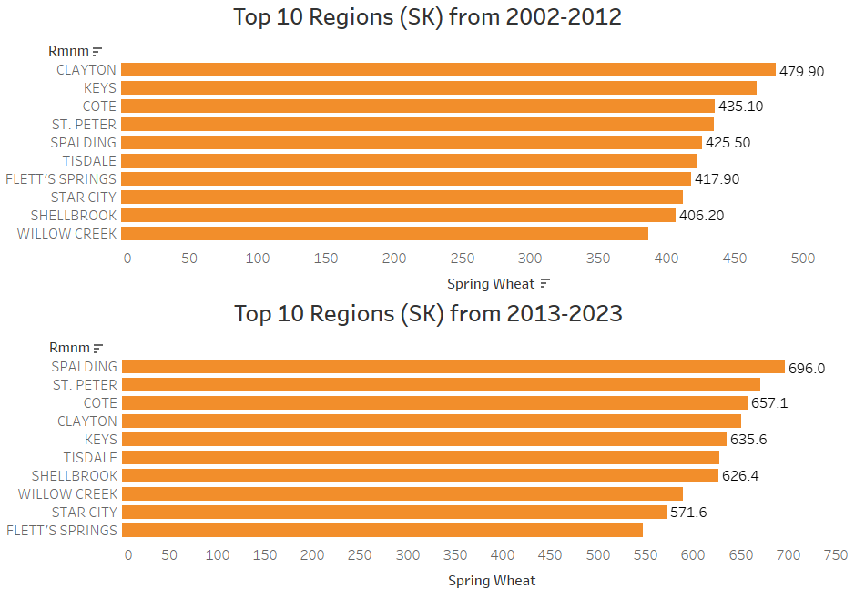
Top 10 Regions in last 20 years comparison

Slide 6
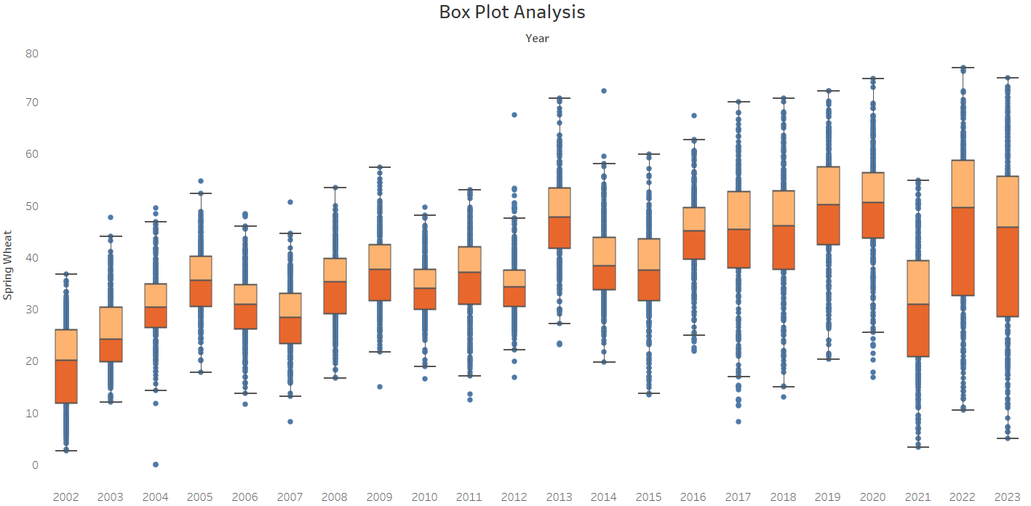
Box Plot Analysis for last 20 years

Slide 7
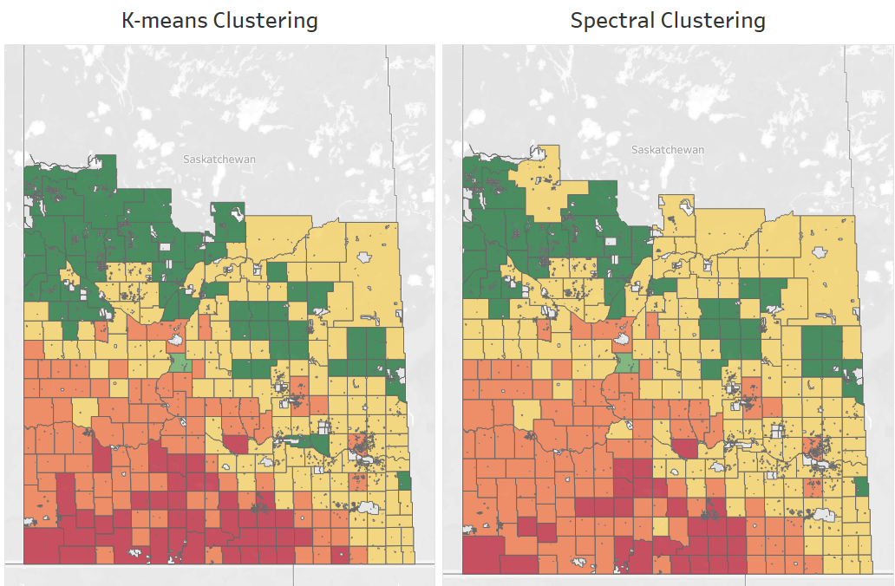
Unsupervised Machine Learning

Slide 8
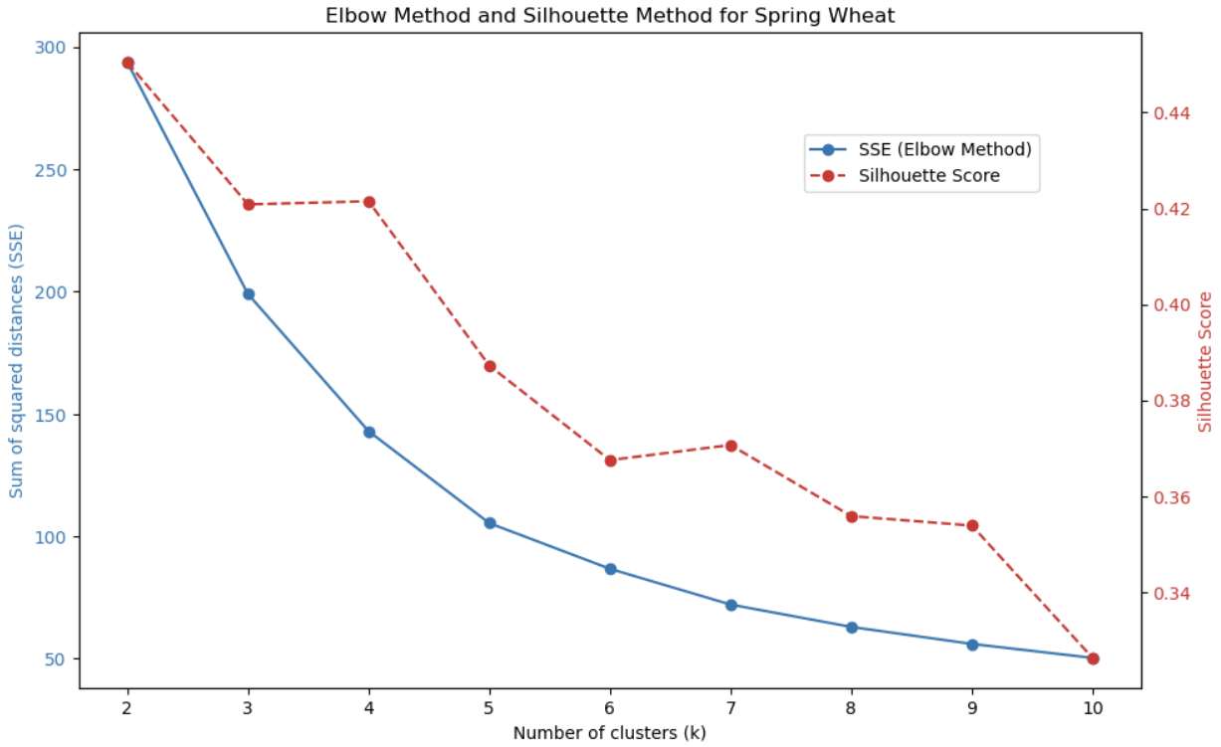
Unsupervised Machine Learning

Slide 9
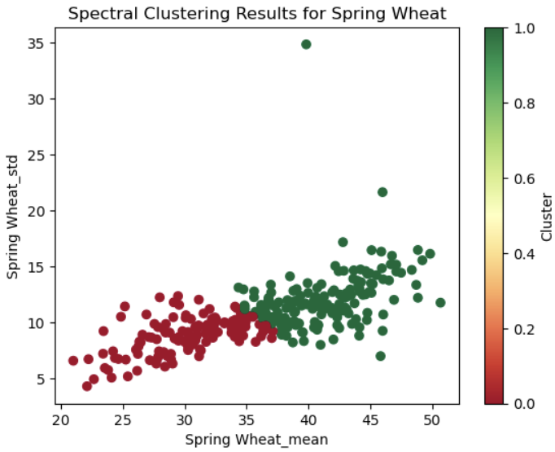
Unsupervised Machine Learning
Optimal number of clusters for Spring Wheat: 2

Slide 10
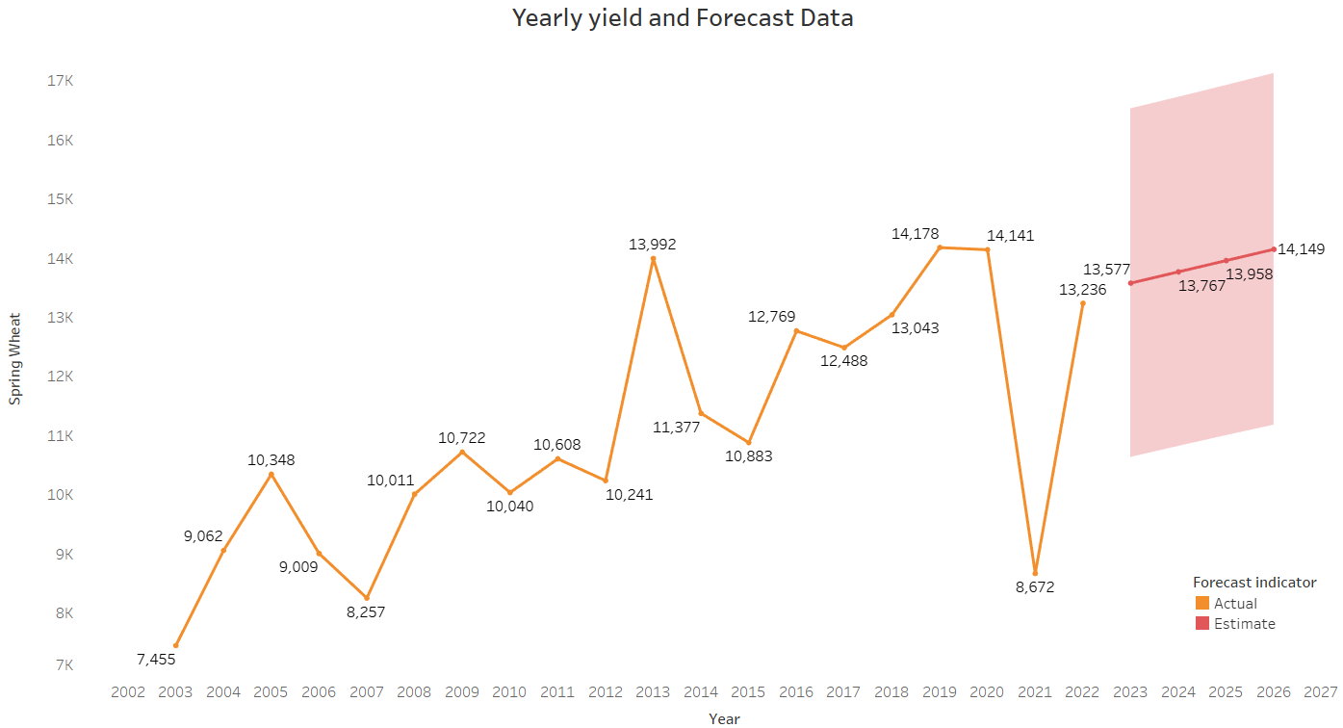
Yearly Yield Data and Forecast Analysis

Slide 11

Conclusion
As per analysis, only few of the regions are growing the Wheat crop so other areas should also take that opportunity as it can lead to crop rotation also.
Spalding is one of the top city in wheat production in overall Saskatchewan.
Saskatchewan is still the top province in Spring Wheat crop yielding after the widespread drought decreased production in overall Canada by 38%.

Slide 12
Thank You

